Slide 1


Data Visualization

Slide 2
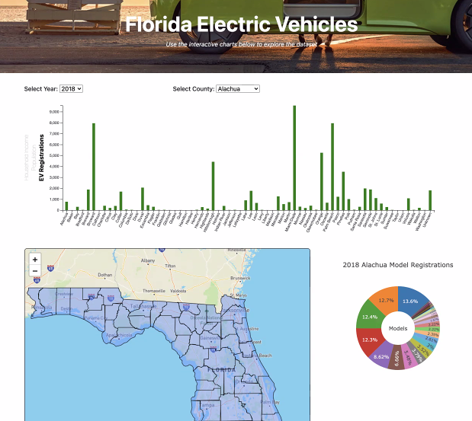
Dashboard app

Slide 3
Interactive Bar Chart comparing Household income, population & EV vehicle registration by counties

Slide 4
Interactive Map will include EV stations in each county

Slide 5
Static Pie Chart Will show EV Vehicles total models per County along with their market penetration Percentage

Slide 6

QUESTIONS?

